Slide 1

#ngindore-zero to hero in angular
INTERCORRELATION OF COMPUTER VISION WITH ANGULAR AND OTHER FRAMEWORKS
By Deepanshu Bhinda
CEO TDB TECHNOLOGIES

Slide 2
ABOUT ME
B.tech From Savitribai Phule Pune University.
Former data scientist at Codenscious Technologies Pvt Ltd.
Computer vision expert & CEO at TDB Technologies.
Writer at TowardsDataScience.Com
Intel @Edge AI scholar.
Competitive programmer tutor.

Slide 3
CONTENTS
What is AI
What is Data Science, Machine Learning & Data Science
Comparison
Why python?
What is computer vision
Application areas
Role of angular & other frameworks in AI
How?
How angular, computer vision & IOT are interconnected
Q&A

Slide 4
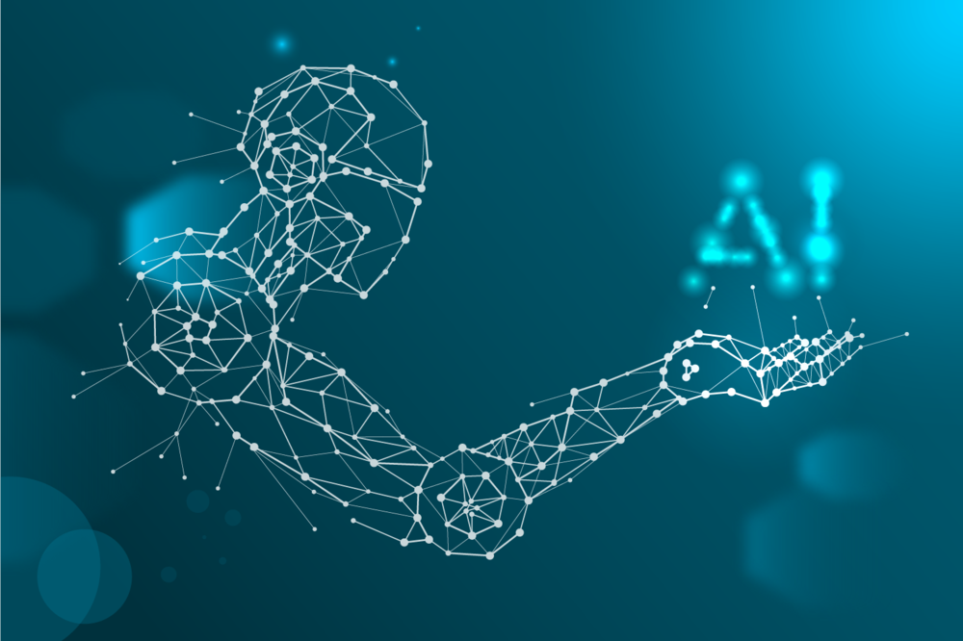
WHAT IS AI

Slide 5
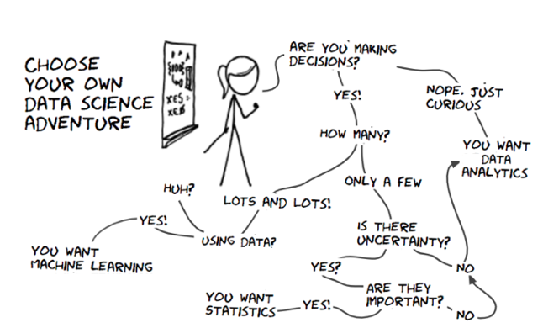
What is Data Science, Machine Learning & DEEP LEARNING

Slide 6
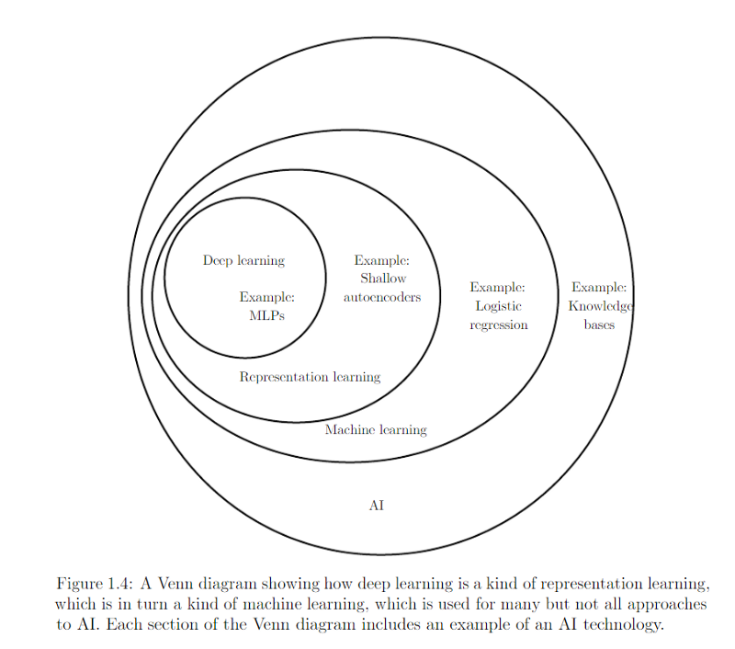
COMPARISON

Slide 7
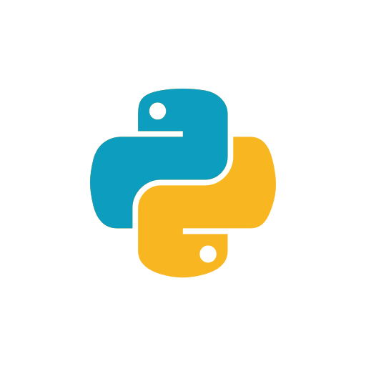
Why python?
Python is an interpreted, high-level, general-purpose programming language. Created by Guido van Rossum and first released in 1991, Python's design philosophy emphasizes code readability with its notable use of significant whitespace.

Slide 8
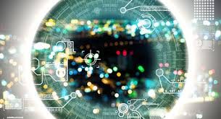
What is computer vision

Slide 9
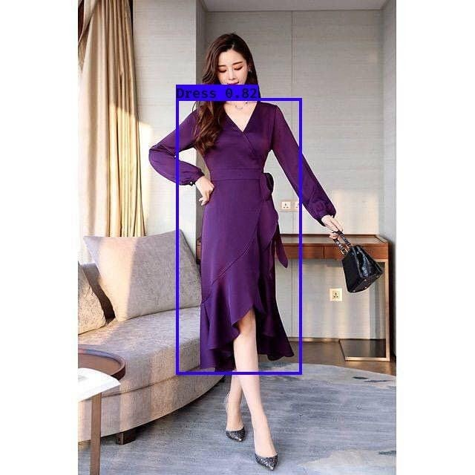
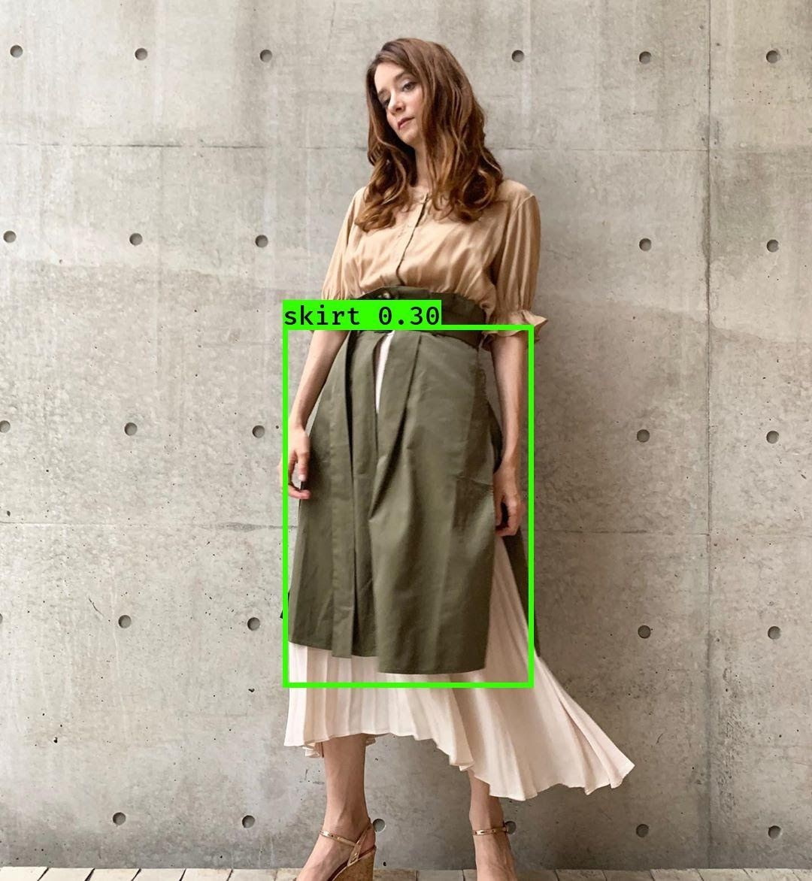
Application areas (OUR PROJECTS)
Fashion Style Classification

Slide 10
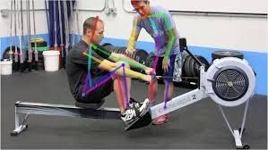
GYM AI

Slide 11
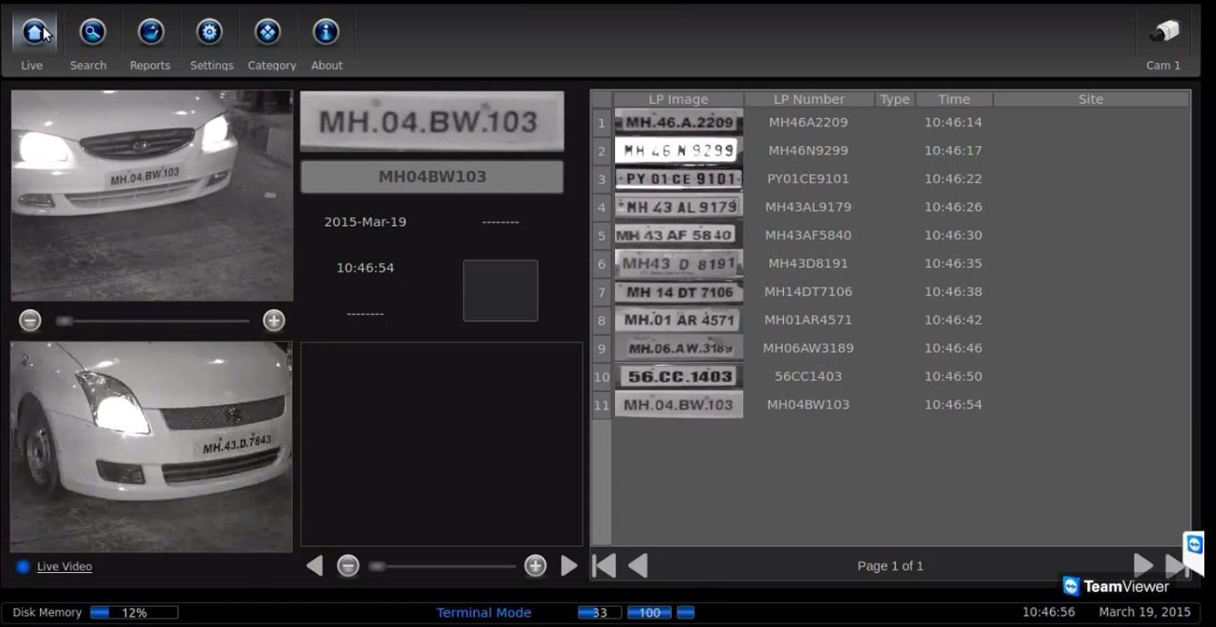
Automatic License Plate Recognition

Slide 12
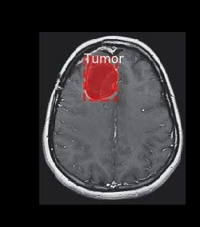
Brain MRI Images classification

Slide 13
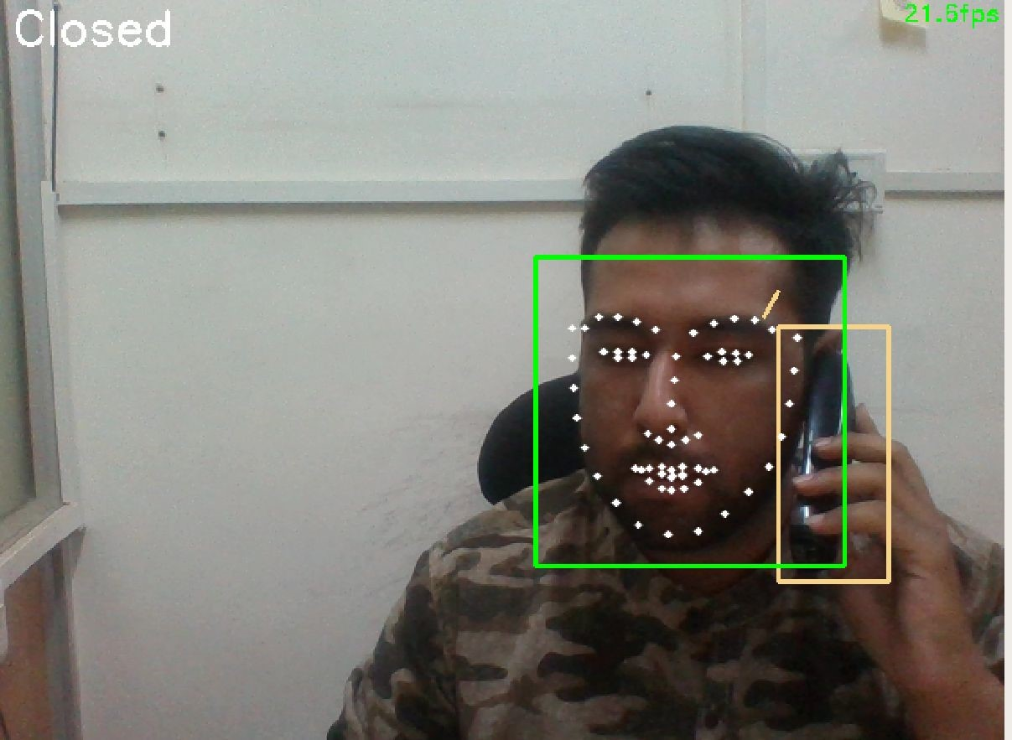
Driver Drowsiness Detection System

Slide 14
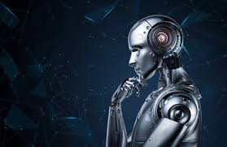
Role of angular & other frameworks in AI
Web Applications
API Integration
Cloud Interfacing
BUT HOW?

Slide 15



Tools
Tensorflow.js
Opencv.js
Node.js

Slide 16
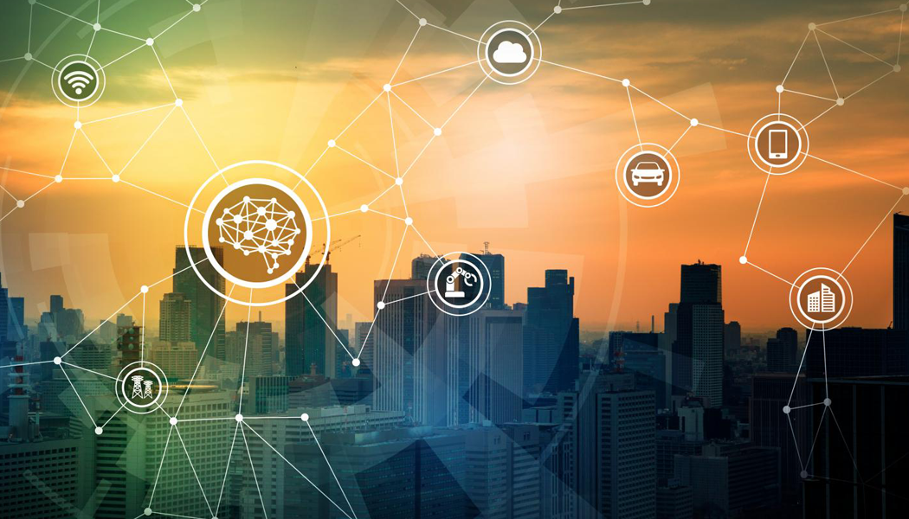
How angular, computer vision & IOT are interconnected
EDGE AI

Slide 17
Q&A
How to start- Explain
Can a person having different domain start on this?
Does it affect on model speed?
Feel free to ask!

Slide 18
THANK YOU

